Slide 1
ANTI SLEEPING GLASS

Slide 2
SYNOPSIS
ABSTRACT
INTRODUCTION
INTERNET OF THINGS
REQUIREMENTS
SOFTWARE
HARDWARE
WORKING
CIRCUIT DIAGRAM
PROGRAM
ADVANTAGES
APPLICATION
CONCLUSION

Slide 3
ABSTRACT:
In modern-times owing to hectic schedules it becomes very difficult to remain active
all the time. Falling asleep on the wheel can lead to serious consequences, there may
be accidents and people may even lose their lives.
So to address this issue, we have come up with a Driver Anti - Sleep Glass Device.
This system alerts the user if he/she falls asleep at the wheel thereby, avoiding the
accidents and saving lives.

Slide 4
INTRODUCTION:
This glasses alerts the driver whenever he is getting into sleep while driving the vehicle.
Since sleeping on wheels is dangerous sometimes it may converts into fettle accidents can leads to death.
So to prevent such consequences of accident we can use this gadget to alert the driver when he feels drowsiness.

Slide 5
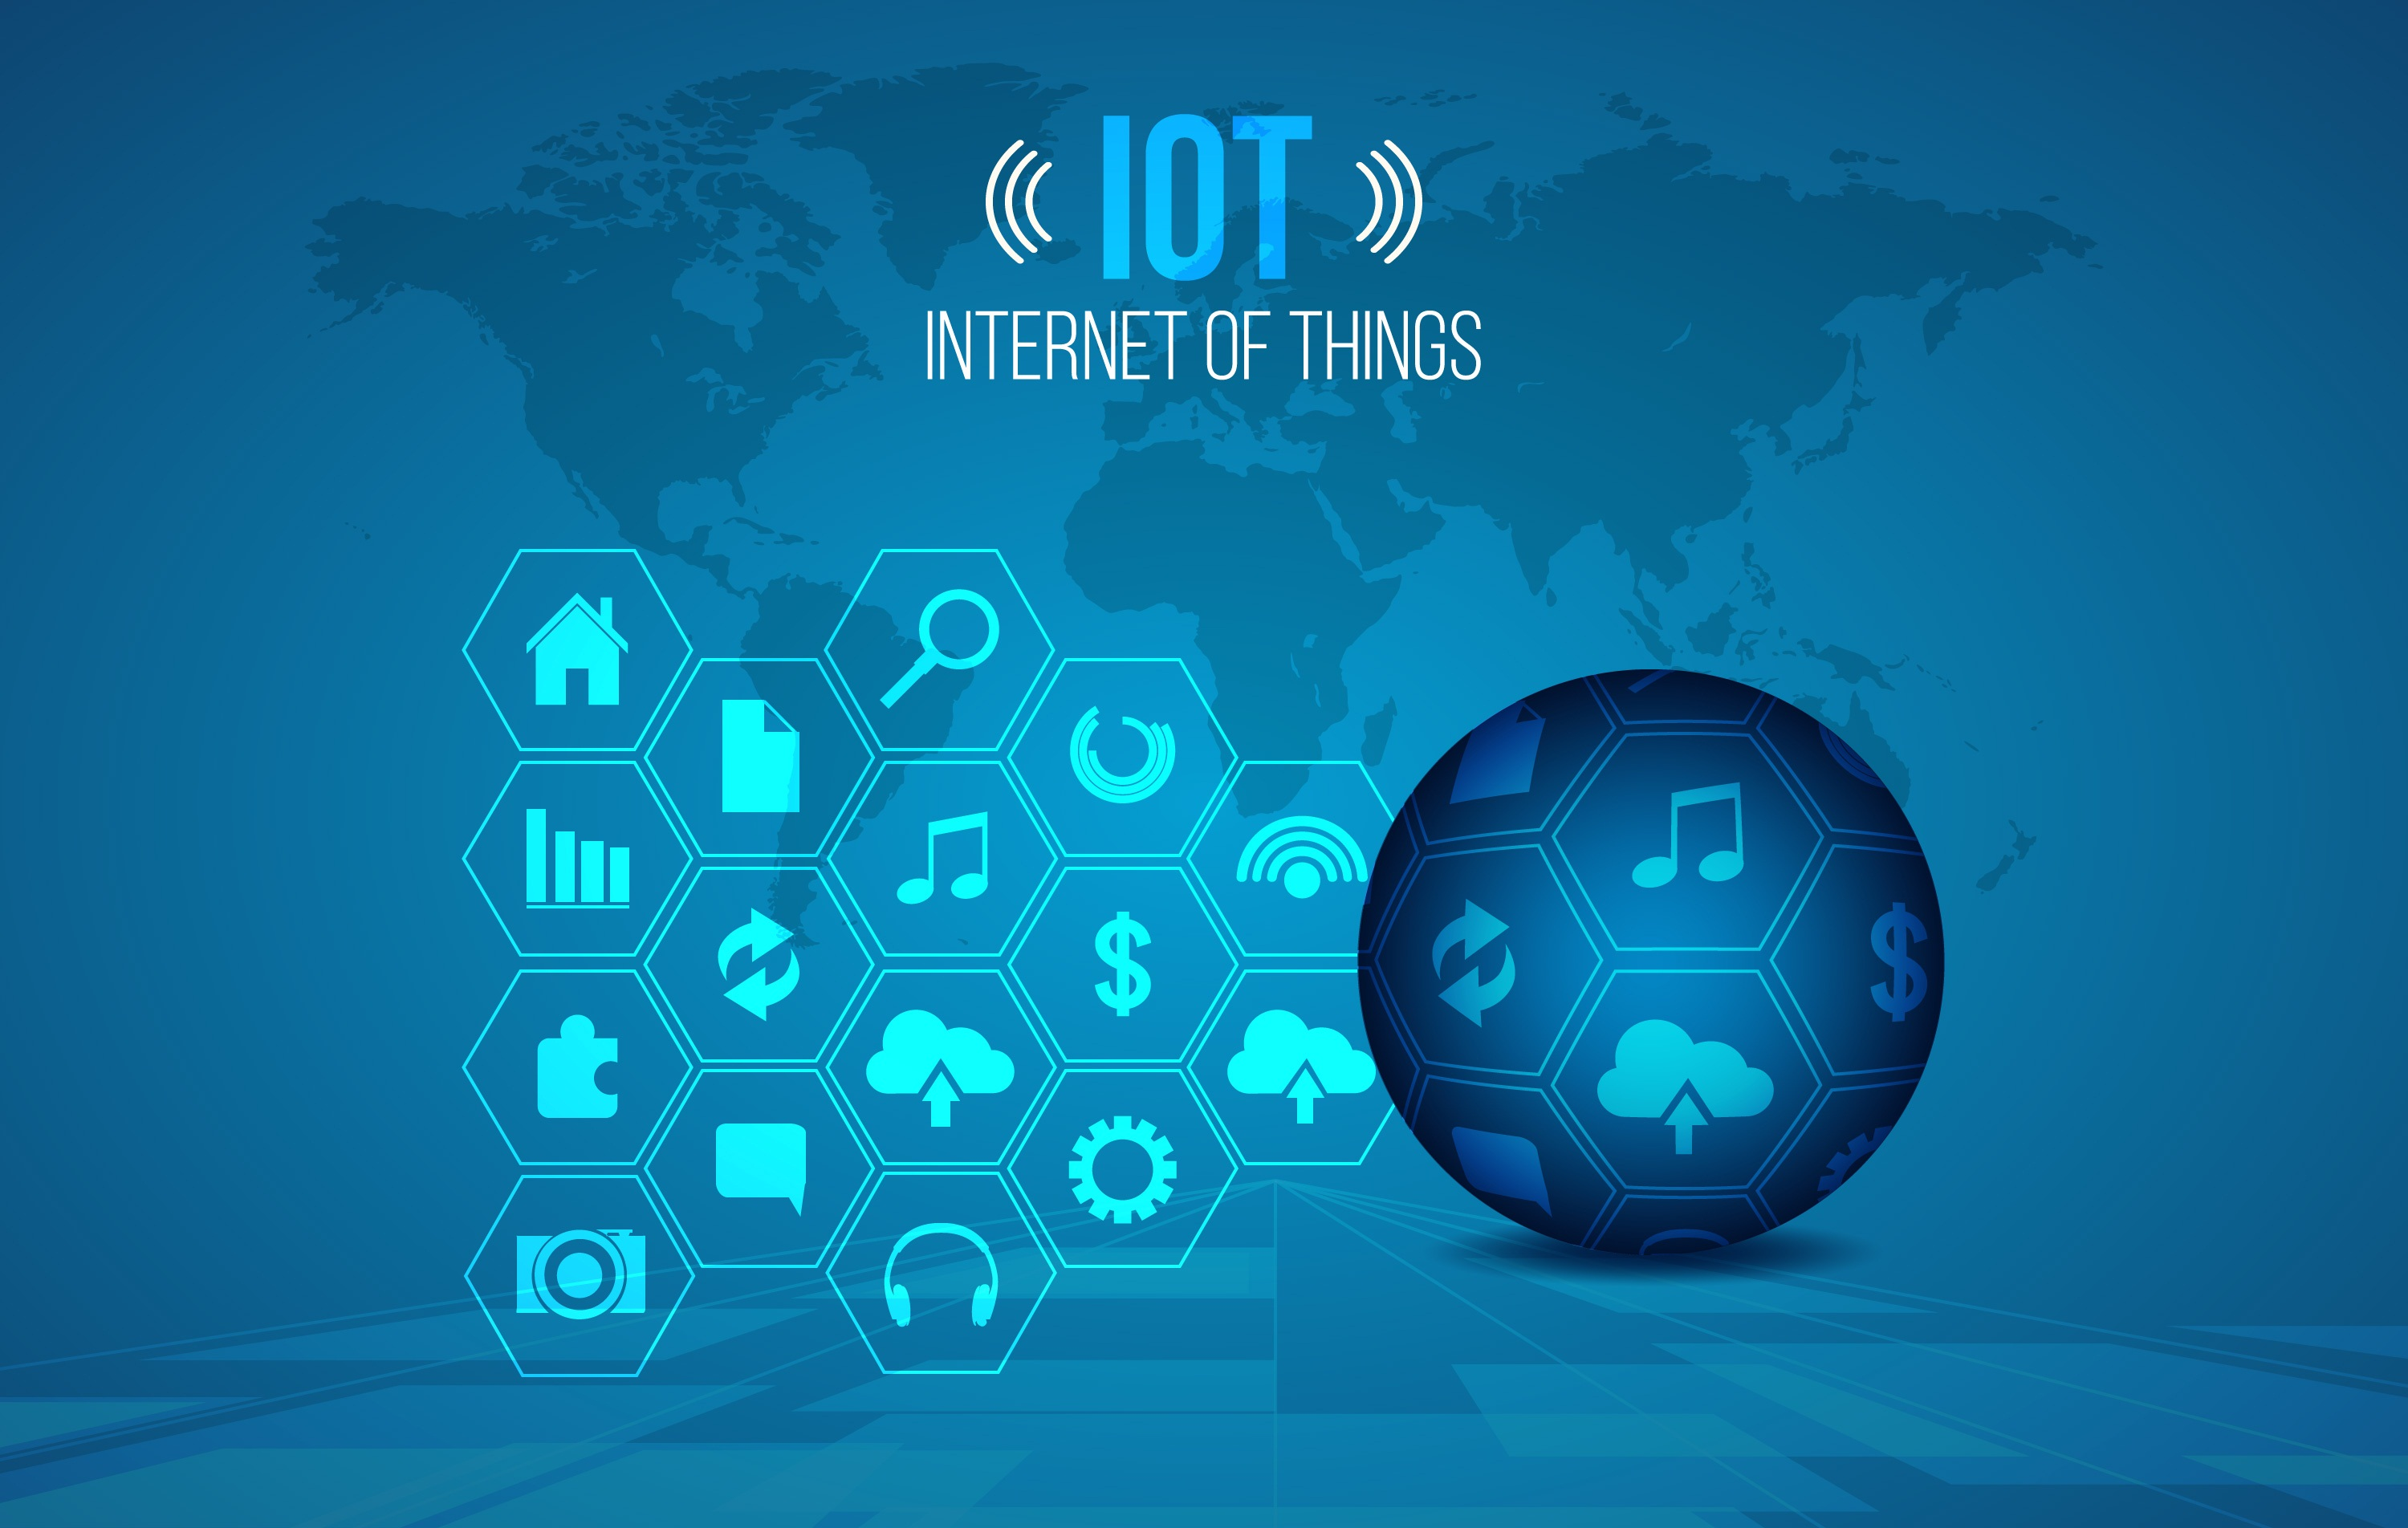
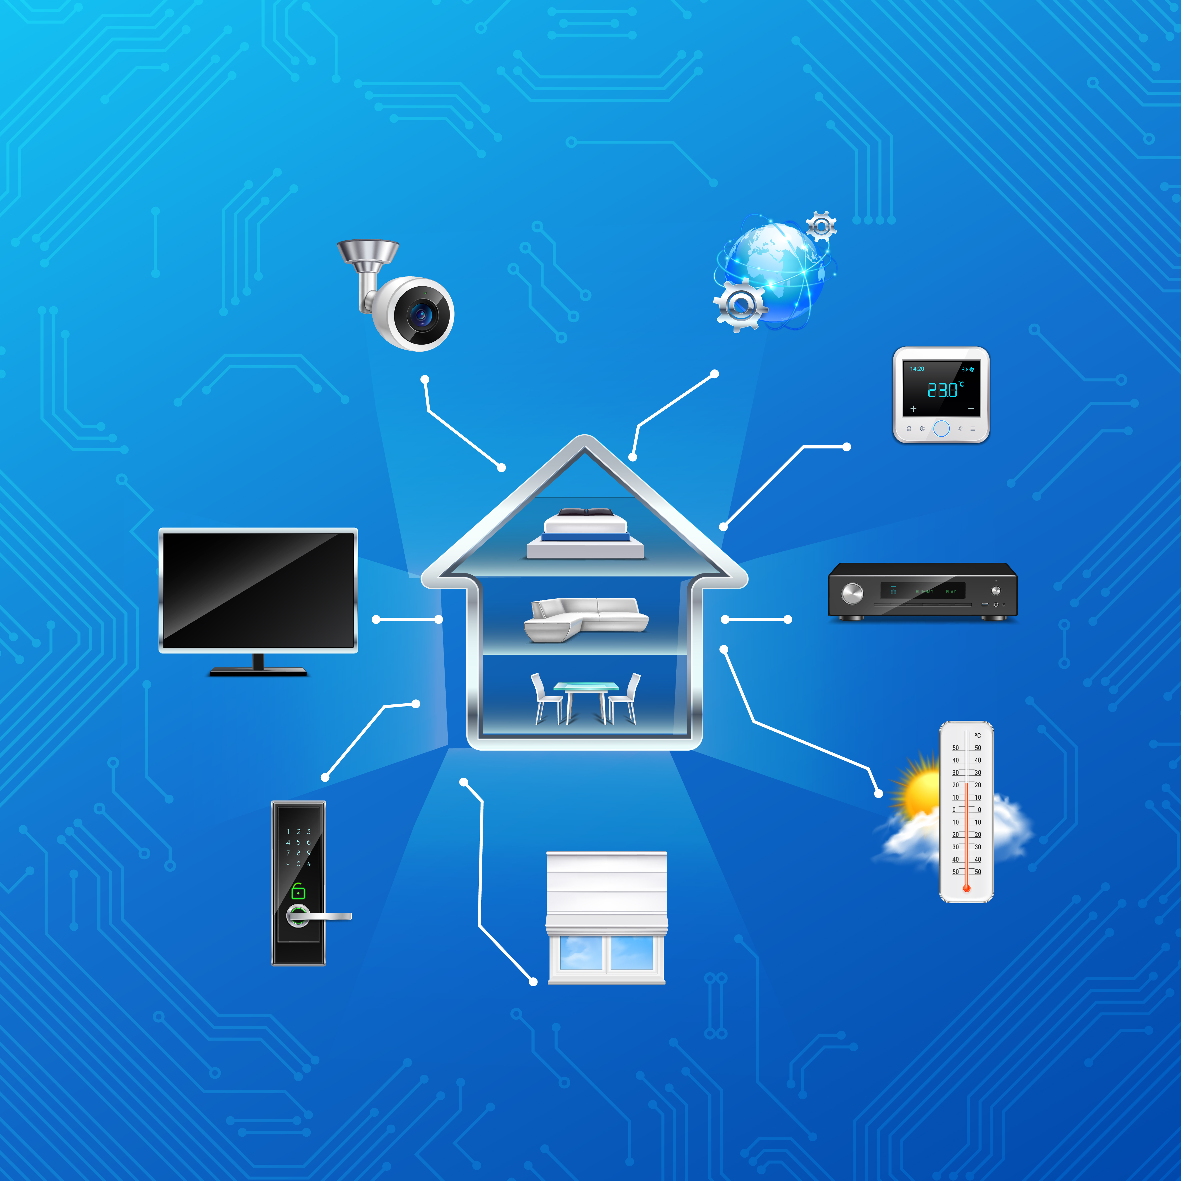
INTERNET OF THINGS:
The Internet of Things (IoT) is a system of interrelated physical devices, vehicles, buildings, and other items that are embedded with sensors, software, and network connectivity, allowing them to collect and exchange data.

Slide 6


REQUIREMENTS:
SOFTWARE:
Tinkercad:
Tinkercad is a free web app for 3D design, electronics, and coding. We're the ideal introduction to Autodesk, a global leader in design and make technology.
2.Arduino IDE:
The Arduino Integrated Development Environment (IDE) - contains a text editor for writing code, a message area, a text console. It connects to the Arduino hardware to upload programs and communicate with them.

Slide 7
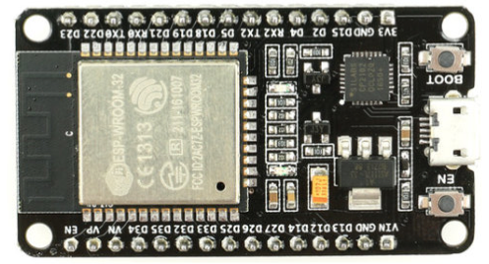
HARDWARE:
1. ESP32:
ESP32 is a low-cost, low-power Microcontroller with an integrated Wi-Fi module and also Bluetooth.
Operating Voltage: 5V
Flash Memory:4 MB of which 512 KB used by bootloader

Slide 8
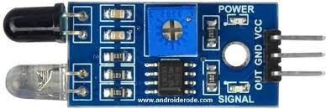
2. IR Sensor:
An Infrared Sensor(IR Sensor) is a radiation-sensitive optoelectronic component with a spectral sensitivity in the infrared wavelength range 780nm. IR sensors are now widely used in motion detectors, which are used in building services to switch on lamps or in alarm systems .

Slide 9
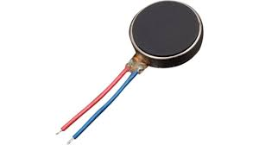
3. Vibration Motor:
A Vibrator is a mechanical device to generate vibrations. The Vibration sensor is also called a piezoelectric sensor. This sensor uses the while measuring the acceleration, pressur, temperature, force otherwise strain by changing to an electrical charge.

Slide 10
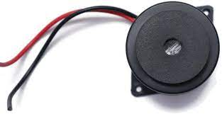
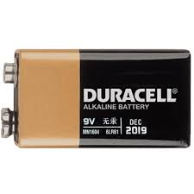
4. Buzzer:
A buzzer or beeper is an audio signaling device, which may be meachanical .
Typical uses of buzzer and beepers include alarm device , timers, train and
generates a sound from an incoming electrical signal.
5. Battery
A Battery is a power source of electronic device and also is a device that stores
chemical energy and converts it to electrical energy.

Slide 11
WORKING:
Whenever the driver feels sleepy sensor which is present in the device detects and sends the information to the circuit which further leads to buzzer to sound an intermediate beep, vibration sensor to vibrations and also email sending to supervisor.
The buzzer and vibration sensor will continuously beep and vibrations until the driver comes back is in normal position. Whenever sensor sences that driver is in normal the buzzer and vibration sensor turn off.

Slide 12
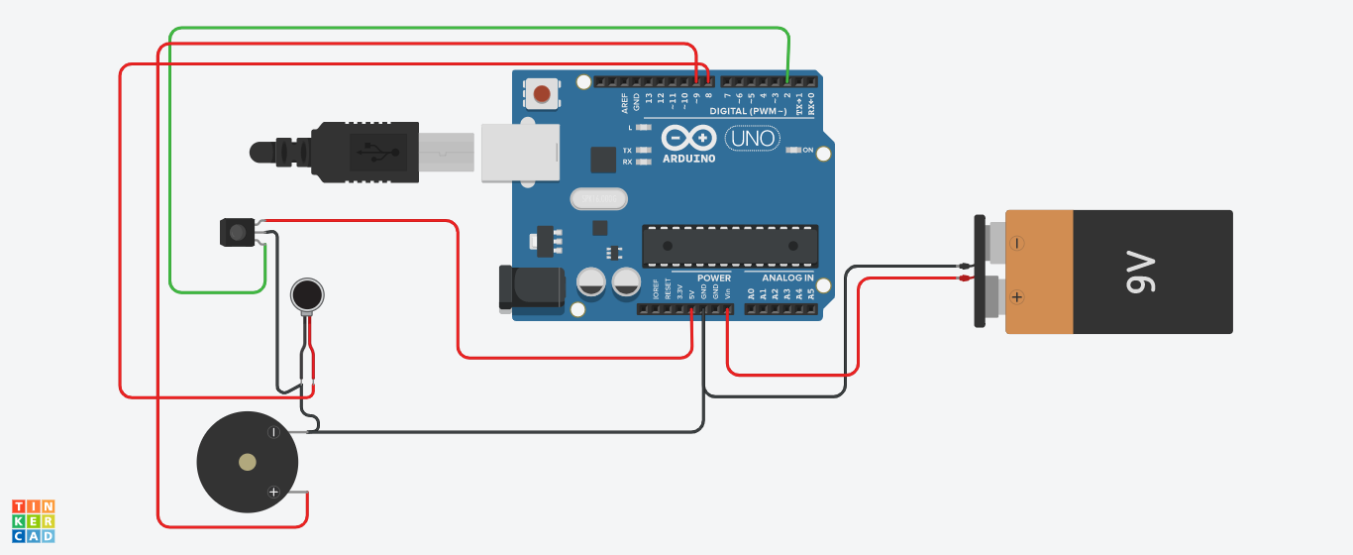
CIRCUIT DIAGRAM:

Slide 13
PROGRAM:
#include <WiFi.h>
#include <AsyncTCP.h>
#include <ESPAsyncWebSrv.h>
#include "ESP32_MailClient.h"
const char* ssid = "GANGATHARAN";
const char* password = "skymars2106";
#define emailSenderAccount "espantisleepingglass@gmail.com"
#define emailSenderPassword "tpnliveoeegaynxu"
#define smtpServer "smtp.gmail.com"
#define smtpServerPort 465
#define emailSubject "[ALERT] ESP32 Driver Sleep"
String inputMessage = "massganga82@gmail.com";
String enableEmailChecked = "checked";
String inputMessage2 = "true";
String inputMessage3 = "Your Driver was sleeping. Please Content us";

Slide 14
const char index_html[] PROGMEM = R"rawliteral(
<!DOCTYPE HTML><html><head>
<title>Email Notification with Sleeping</title>
<meta name="viewport" content="width=device-width, initial-scale=1">
</head><body>
<h2>ESP Email Notification</h2>
<form action="/get">
Email Address <input type="email" name="email_input" value="%EMAIL_INPUT%" required><br>
Enable Email Notification <input type="checkbox" name="enable_email_input" value="true" %ENABLE_EMAIL%><br>
ESP32 Output <input type="String" step="0.1" name="esp32_input" value="%ESP32_Output%" required><br>
<input type="submit" value="Submit">
</form>
</body></html>)rawliteral";
void notFound(AsyncWebServerRequest *request) {
request->send(404, "text/plain", "Not found");
}

Slide 15
AsyncWebServer server(80);
String processor(const String& var){
//Serial.println(var);
if(var == "EMAIL_INPUT"){
return inputMessage;
}
else if(var == "ENABLE_EMAIL"){
return enableEmailChecked;
}
else if(var == "ESP32_Output"){
return inputMessage3;
}
return String();
}
// Flag variable to keep track if email notification was sent or not
bool emailSent = false;

Slide 16
const char* PARAM_INPUT_1 = "email_input";
const char* PARAM_INPUT_2 = "enable_email_input";
const char* PARAM_INPUT_3 = "esp32_input";
SMTPData smtpData;
void setup() {
pinMode(14, INPUT);
pinMode(27, OUTPUT);
pinMode(26, OUTPUT);
Serial.begin(115200);
WiFi.mode(WIFI_STA);
WiFi.begin(ssid, password);
if (WiFi.waitForConnectResult() != WL_CONNECTED) {
Serial.println("WiFi Failed!");
return;
}

Slide 17
Serial.println();
Serial.println("ESP IP Address: http://");
Serial.println(WiFi.localIP());
server.on("/", HTTP_GET, [](AsyncWebServerRequest *request){
request->send_P(200, "text/html", index_html, processor);
});
server.on("/get", HTTP_GET, [] (AsyncWebServerRequest *request) {
if (request->hasParam(PARAM_INPUT_1)) {
inputMessage = request->getParam(PARAM_INPUT_1)->value();
if (request->hasParam(PARAM_INPUT_2)) {
inputMessage2 = request->getParam(PARAM_INPUT_2)->value();
enableEmailChecked = "checked";
}
else {
inputMessage2 = "false";
enableEmailChecked = "";
}

Slide 18
if (request->hasParam(PARAM_INPUT_3)) {
inputMessage3 = request->getParam(PARAM_INPUT_3)->value();
}
}
else {
inputMessage = "No message sent";
}
Serial.println(inputMessage);
Serial.println(inputMessage2);
Serial.println(inputMessage3);
request->send(200, "text/html", "HTTP GET request sent to your ESP.<br><a href=\"/\">Return to Home Page</a>");
});
server.onNotFound(notFound);
server.begin();
}
void loop() {
if(digitalRead(14)==LOW)
{
delay(3000);
digitalWrite(27, HIGH);
digitalWrite(26, HIGH);
}

Slide 19
else
{
digitalWrite(27, LOW);
digitalWrite(26, LOW);
}
if(digitalRead(14)==LOW && inputMessage2 == "true"){
String emailMessage = String("Your driver was sleeping ");
if(sendEmailNotification(emailMessage)) {
Serial.println(emailMessage);
emailSent = true;
}
else {
Serial.println("Email failed to send");
}
}
}
bool sendEmailNotification(String emailMessage){
smtpData.setLogin(smtpServer, smtpServerPort, emailSenderAccount, emailSenderPassword);
smtpData.setSender("ESP32", emailSenderAccount);
smtpData.setPriority("High");

Slide 20
smtpData.setSubject(emailSubject);
smtpData.setMessage(emailMessage, true);
smtpData.addRecipient(inputMessage);
smtpData.setSendCallback(sendCallback);
if (!MailClient.sendMail(smtpData)) {
Serial.println("Error sending Email, " + MailClient.smtpErrorReason());
return false;
}
smtpData.empty();
return true;
}
void sendCallback(SendStatus msg) {
Serial.println(msg.info());
if (msg.success()) {
Serial.println("----------------");
}
}

Slide 21
ADVANTAGES:
Prevents accidents
Increases safety
Send E-mail for real time alerts
Customizable alert settings
Easy to use
Cost-effective
Improves productivity

Slide 22
APPLICATION:
Transportation:
Drowsy driving prevention with real-time alerts.
Manufacturing:
Fatigue detection for increased safety and productivity.
Healthcare:
Patient safety through fatigue monitoring and alerts.
Aviation:
Alerting pilots and traffic officer to drowsiness in flight and airport.
Military:
Increasing situational awareness through fatigue detection.
Sports:
Monitoring athlete fatigue levels during training.

Slide 23
CONCLUSION:
Anti-Sleep glass are a protect that human life.
If a person falls asleep while driving while wearing these glasses, the glasses
will warn him.
This technology is already available in the market, but these are costly. So my
this concept makes it easy for anyone to purchase the product and at cost less.

